Slide 1
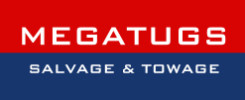

M/V CABRERA fuel oil, cargo & wreck removal, shore cleaning
Mr. Paul Xiradakis
Director of MEGATUGS Salvage & Towage

Slide 2
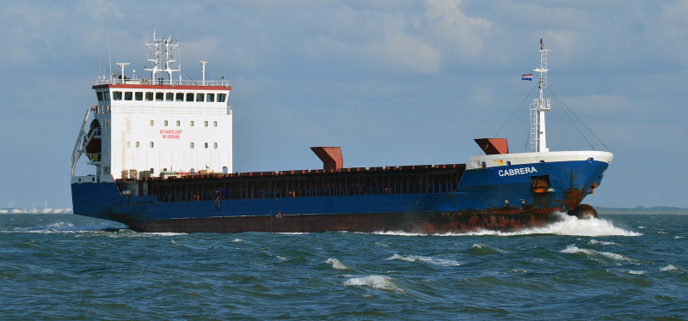
1. The Incident
The Antigua and Barbuda-flagged general cargo vessel Cabrera(4,244 GT, built 2007), hereinafter, referred to as the Casualty, ran aground on the northern coast of Andros Island on 24th December 2016
The Casualty had a length overall of 100 meters with a single hold and 5,300 DWT
The Casualty was enroute from Larymna, Greece to Tornio, Finland laden with a cargo of 3,728 MT of ferronickel in granules
The Casualty was carrying in its tanks 59 MT of fuel oil (IFO 180), 20 MT of Marine Diesel Oil (MDO) & 6 MT of lube oil

Slide 3
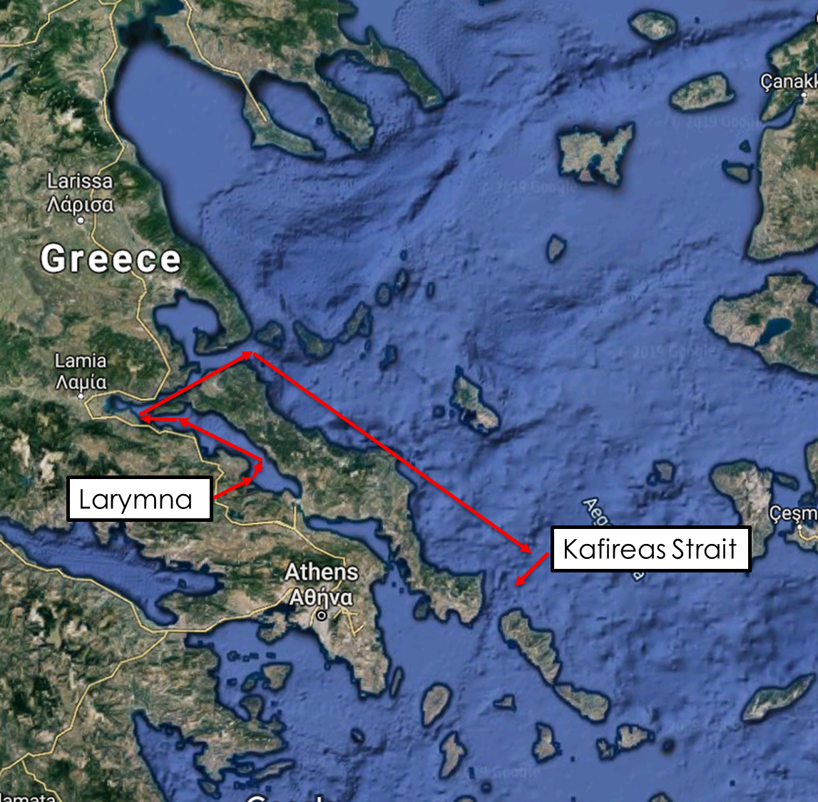
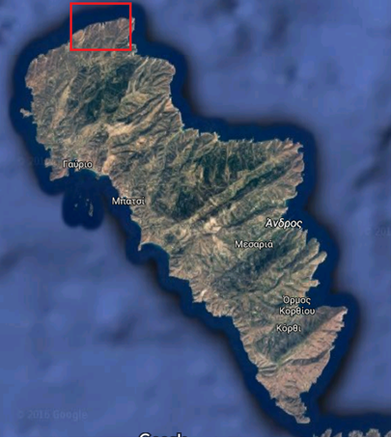
The Incident
The Kafirea Strait between Andros and the famous Cavo d’Oro on the southern tip of Evia Island is one of the most dangerous stretches of water in the Mediterranean
The combination of strong winds, strong currents and rocky shores in the narrow strait makes the area a very dangerous sea passage. A significant number of shipping accidents have happened in the area

Slide 4
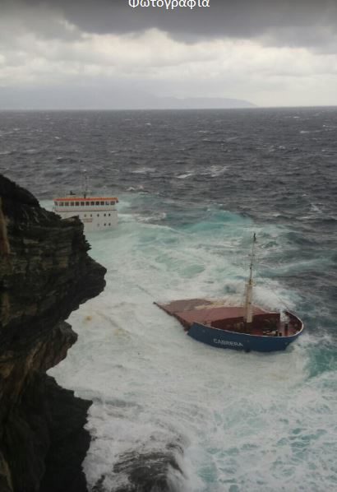
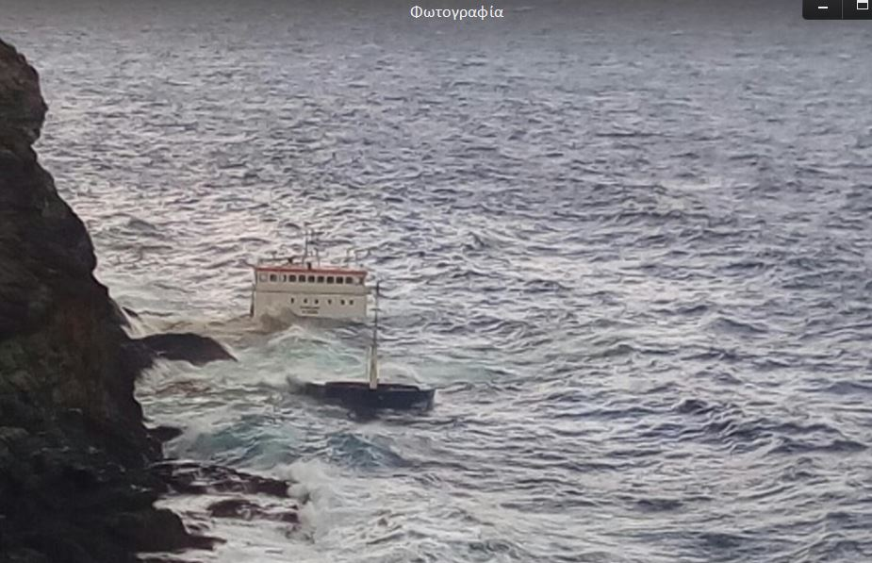
The Incident
The Casualty ran aground and was pushed by the storm against the cliff later
The Casualty suffered hull breaches below the water line, water ingress and developed a list

Slide 5
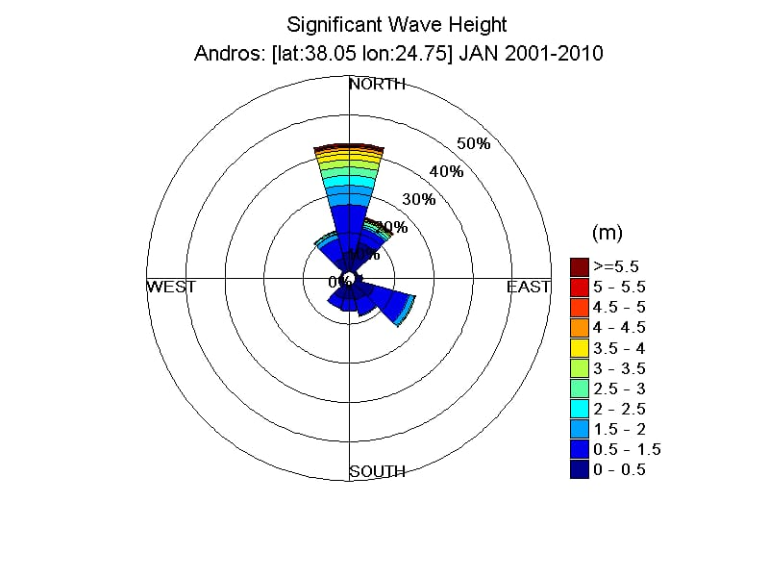
The above Wave Height rose shows that there was only 20-25% (6-8days per month) of suitable weather conditions for Salvors to work safely onsite

Slide 6
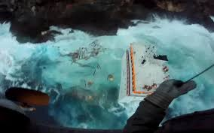
The Incident
The crew reported the accident to the local authorities and requested immediate evacuation due to danger from developing list and breaking of the Casualty
All the nine crew members were rescued by a helicopter of the Greek Navy without reported injuries
While the Casualty was in a semi-submerged condition, the area was hit by the worst storm in 30 years, on 28th December 2016, and the Casualty broke up and sank

Slide 7

Oil from the wreck rapidly spread around the north coast of Andros and polluted 7 beaches
It was the 2nd grounding and total loss on the island in 18 months, and attracted considerable publicity
The local population was very concerned for the impact of the pollution to the island and tourism
The media coverage was intense and mainly negative

Slide 8
The Incident
The company adopted a policy from the outset to deal with these issues by:
i) establishing good relations with the local Authorities and Hellenic Coastguard
ii) regularly sharing information on the planning and progress of the operation
iii) ensuring that all of our staff and contractors looked and behaved professionally and politely with the local population
iv) we also assisted the Coastguard by towing into port without cost a foreign Casualty that had broken down off Andros and was suspected of smuggling

Slide 9

The Incident
Megatugs was contracted for the antipollution works; the salvage of the cargo; the removal of the wreck; and the clean-up and restoration of the polluted beaches
Megatugs cooperated with SMIT Salvage for the oil, cargo and wreck removal operations

Slide 10
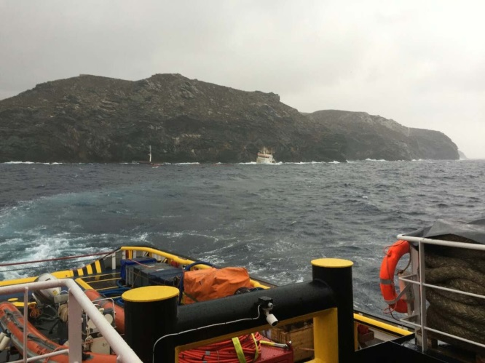
2. Oil removal from Wreck
The salvage tug Pantanassa sailed on speculation to the aid of the Casualty shortly after the incident happened on the 24th Dec 2016
Megatugs proposed working under a LOF contract, but, the Insurers insisted on a commercial contract based on SCOPIC rates
The weather conditions when our first salvage tug arrived onsite were F8 with 3.5 mtr swell
The salvage tug was unable to approach the Casualty due to the adverse weather conditions and floating debris
Deployment of oil booms was not a feasible option under the circumstances

Slide 11
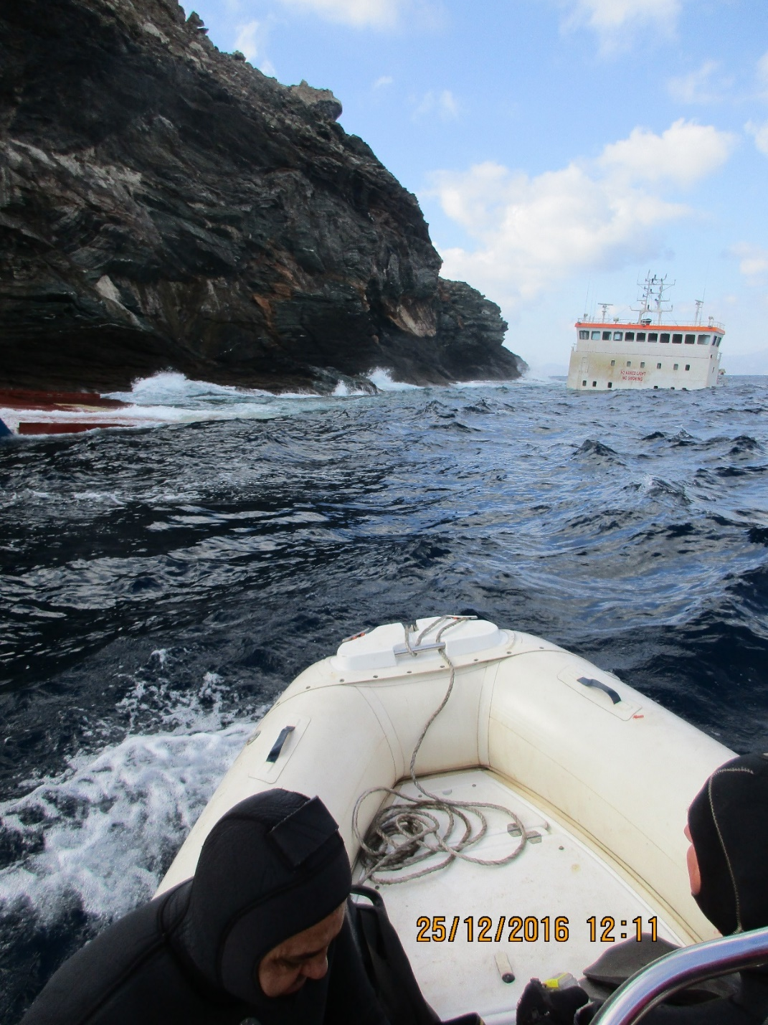
Oil removal from Wreck 25 December 2016
Salvage divers managed to carry out an underwater survey
Embarkation of the salvage team to the Casualty was not feasible due to the high swell
Additional salvage equipment were loaded to the salvage tug during the night hours from another close port in the mainland

Slide 12
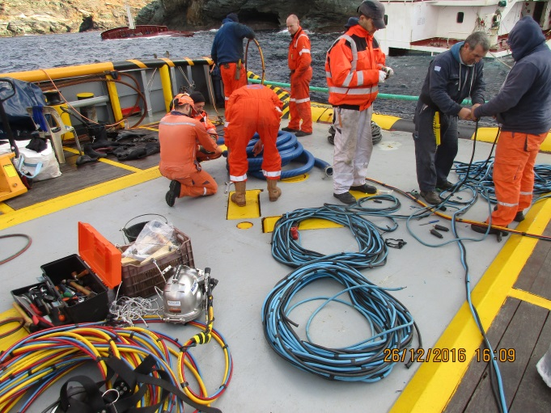
Oil removal from Wreck 26 December 2016
Salvage tug stern moored to Casualty
Divers reported fuel oil leakage coming out from cracks of the damaged starboard side
Salvage team prepared pumps, hoses and air lines for the pumping operation
Divers transferred pumps and connected suction hose to the Casualty for pumping the oil pollutants
Sudden deterioration of weather conditions, enforced the salvage team to postpone the oil removal operation

Slide 13
Oil removal from Wreck 27 December 2016
Adverse weather conditions and heavy swell hampered the oil removal operation from the sea side

Slide 14
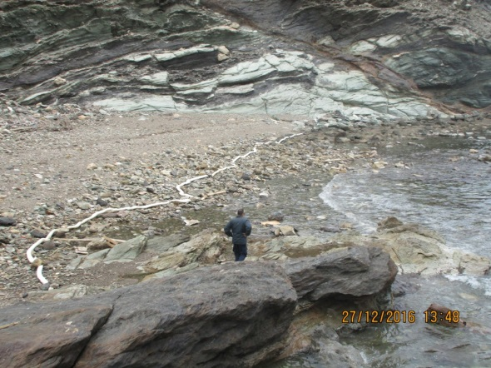
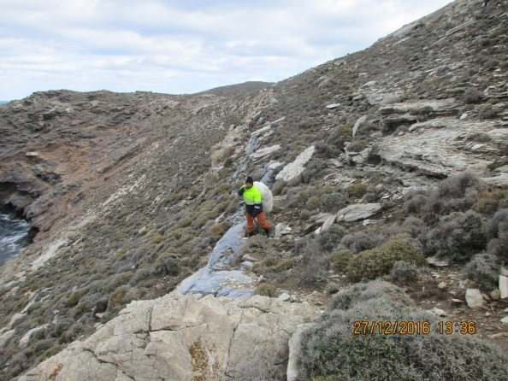
Oil removal from Wreck 27 December 2016
Salvors performed inspections/ works from the shore side
Salvors deployed absorbent materials on a number beaches in the adjacent area
Access to the shoreline proved to be a difficult task

Slide 15
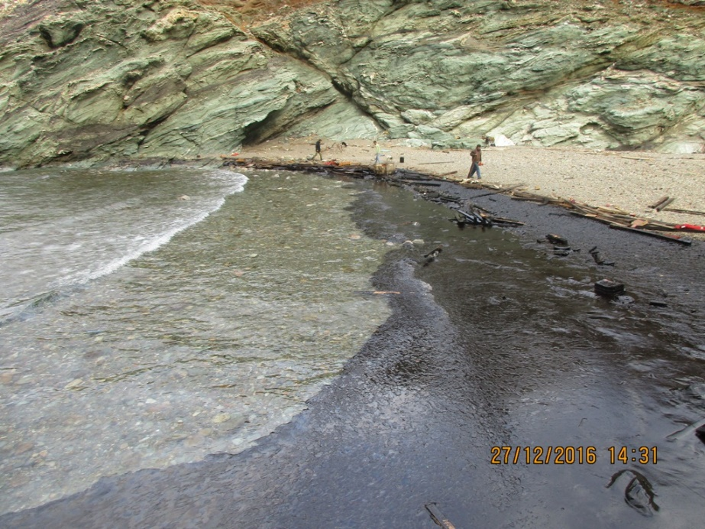
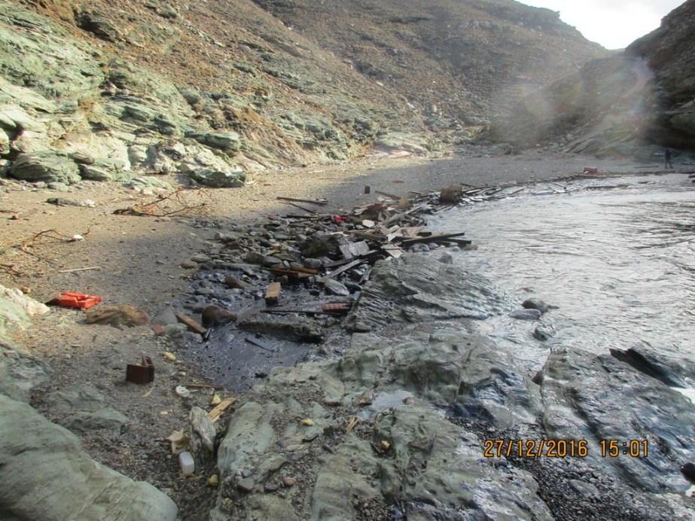
Oil removal from Wreck 27 December 2016
One beach (Lefkidari) was found heavily polluted by the fuel oil which escaped from the Casualty’s tanks
Salvors immediately commenced antipollution works by deploying absorbents, collecting waste and placing oil booms to prevent further pollution of the coast
Salvors managed to deploy oil booms around the Casualty during the late evening hours taking advantage of the short period of improvement of weather condition

Slide 16
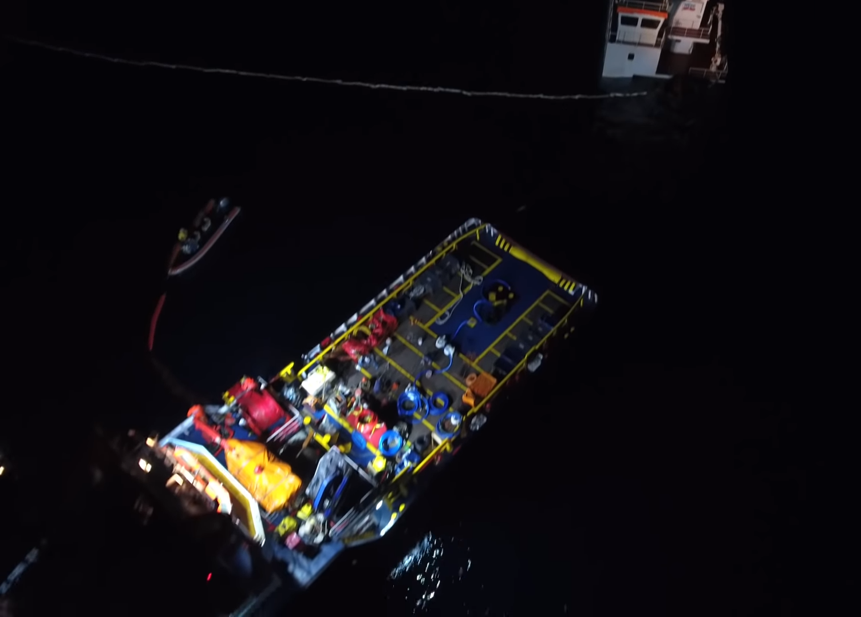
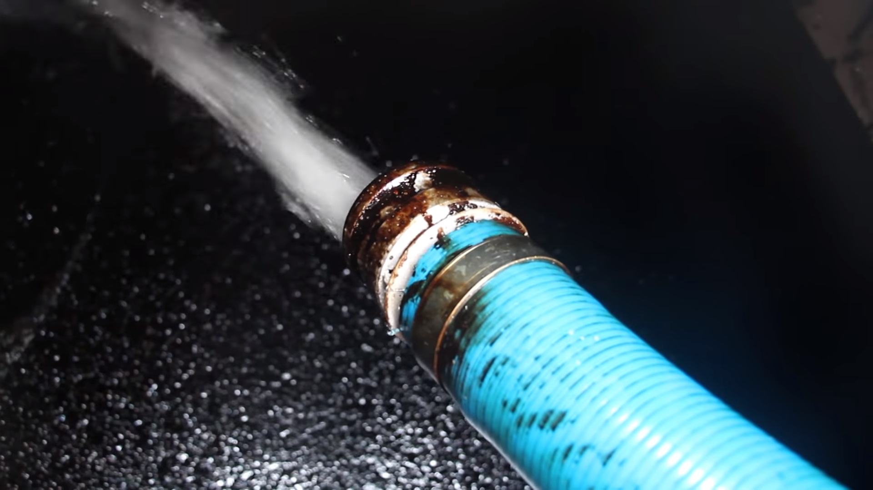
Oil removal from Wreck 28 December 2016
In the early morning hours, the Pantokrator connected hoses to the Casualty for the removal of the bunkers and commenced the pumping process
After a short period of time, Salvors forced to stop again the pumping operation as a result of the sudden deterioration of the weather condition
About 4.6 m3 of heavy fuel oil removed from the wreck to the oil-recovery tanks of the salvage tug

Slide 17
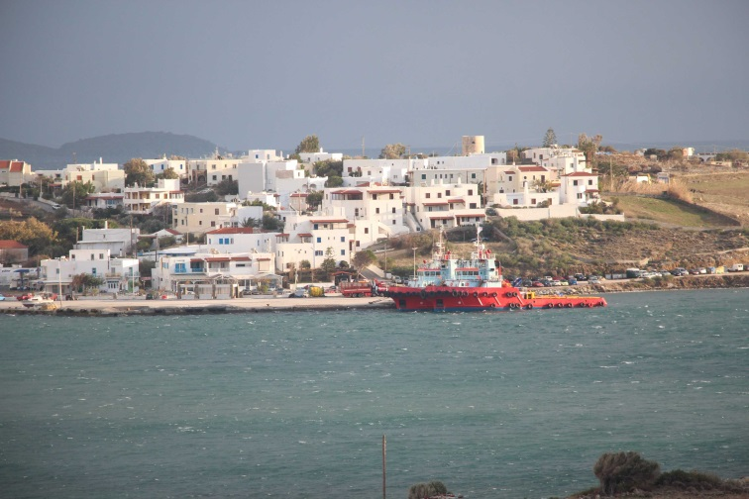
Oil removal from Wreck 27 December 2016
Salvage tugs Pantokrator and Pantanassa forced to seek shelter at Gavrion port to escape from the storm (10-11Bf)
Casualty broken up and disappeared from the sea surface

Slide 18
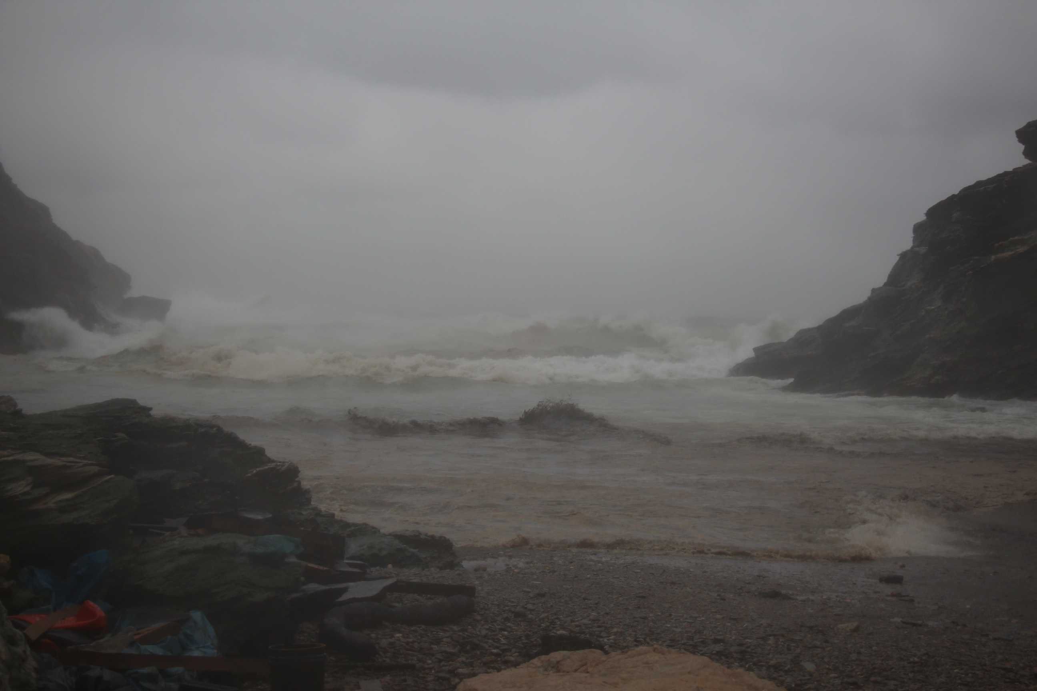
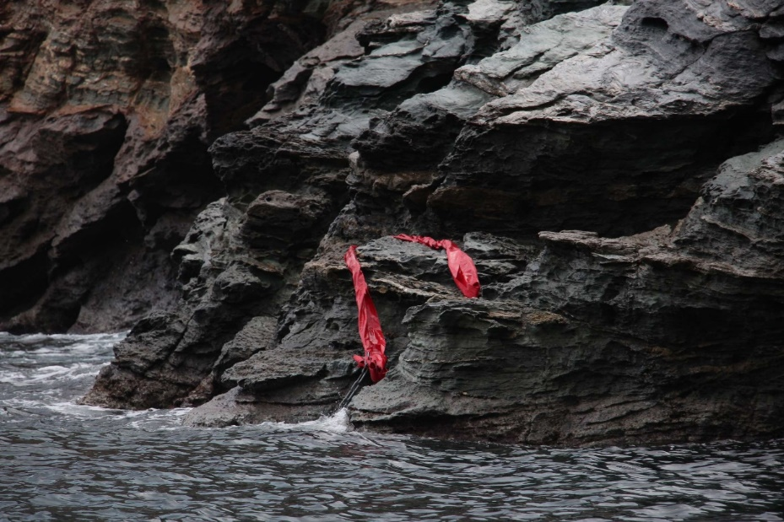
Oil removal from Wreck – 28th December 2016
During the storm days, the high seas brought large quantities of fuel oil to the shore line
The high waves caused a major pollution to the shore line of Andros island
The oil booms deployed on site were lost

Slide 19
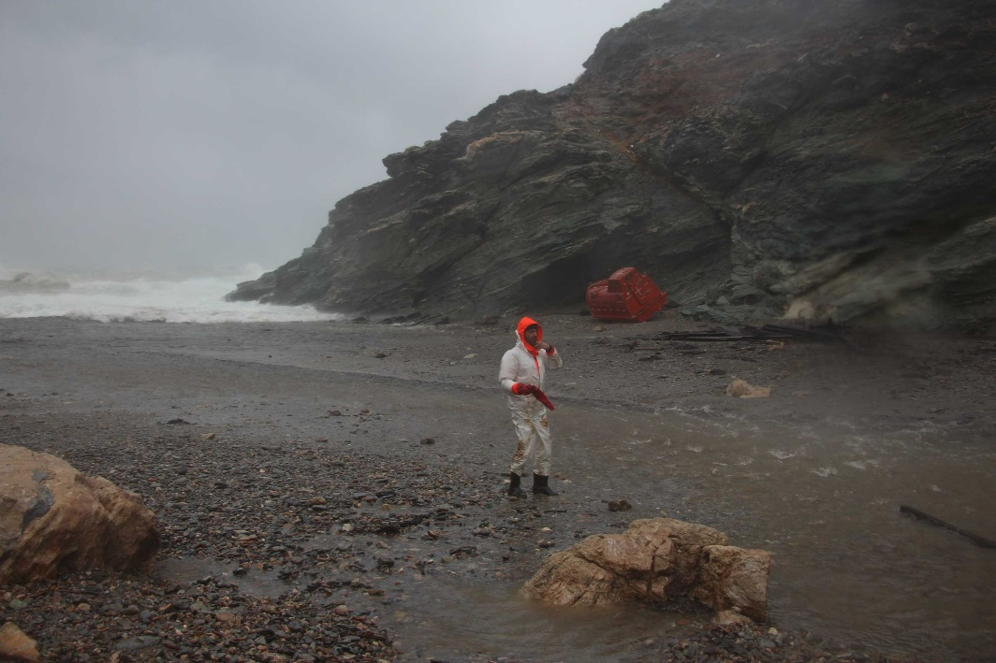
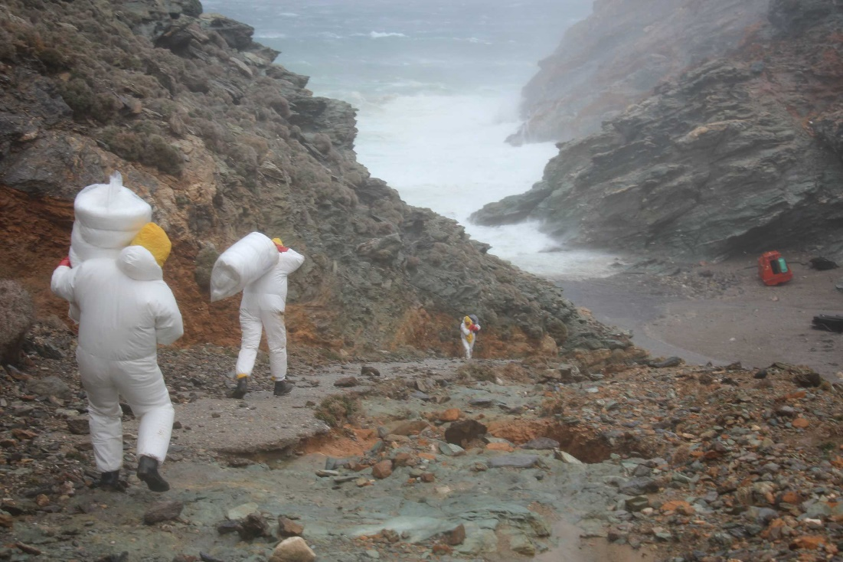
Oil removal from Wreck – 28th December 2016
Salvors and oil spill personnel exercised their best endeavours whilst trying to work from the shore side

Slide 20
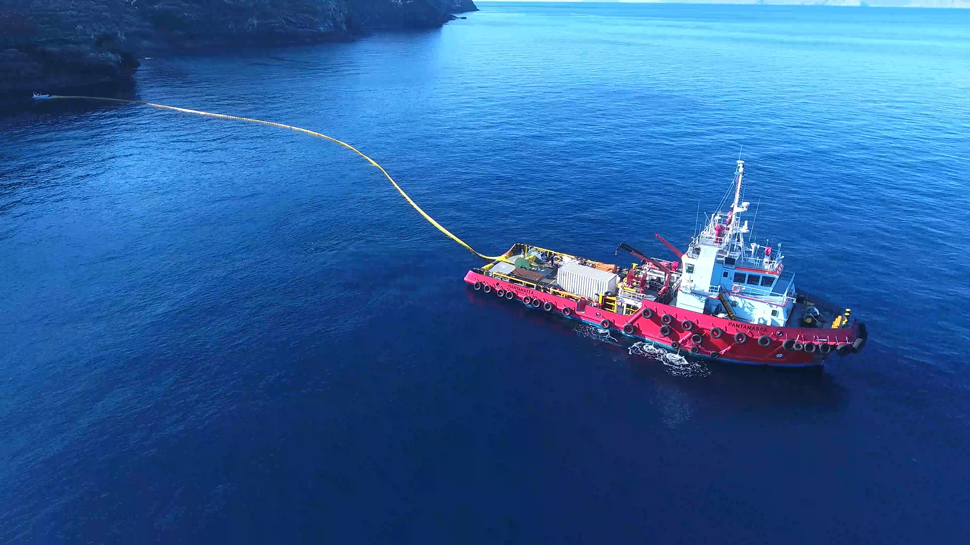
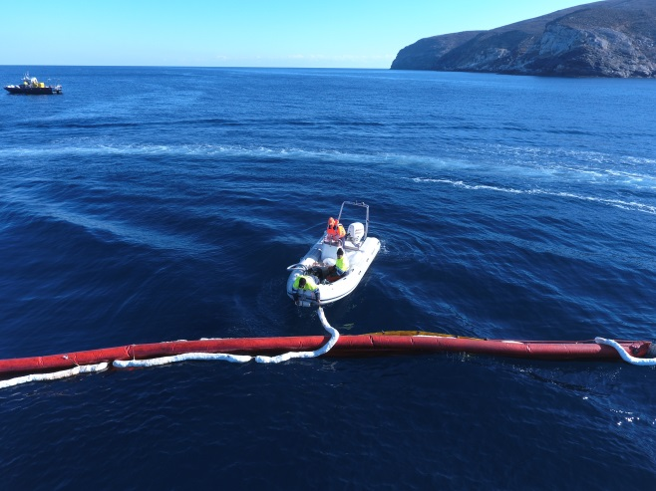
Oil removal from Wreck
Salvors repositioned their resources to the wreck site upon improvement of the weather conditions
Salvage tugs deployed oil booms onsite for the containment of the oil escaping from the wreck
Floating booms were also laid as far as practical across the entrances to several of the beaches
Oil rising to the surface was collected from inside the boom using skimmers and absorbents

Slide 21
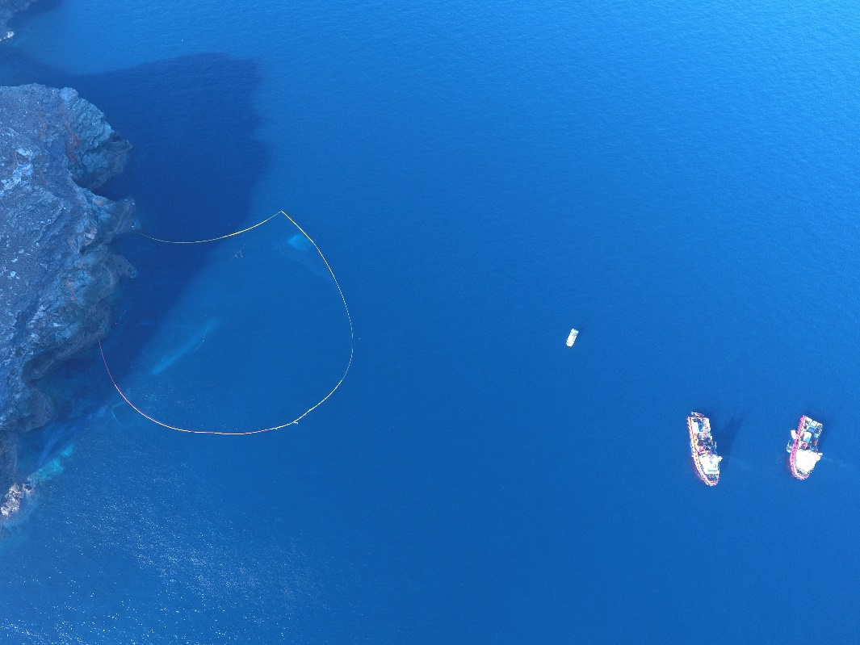
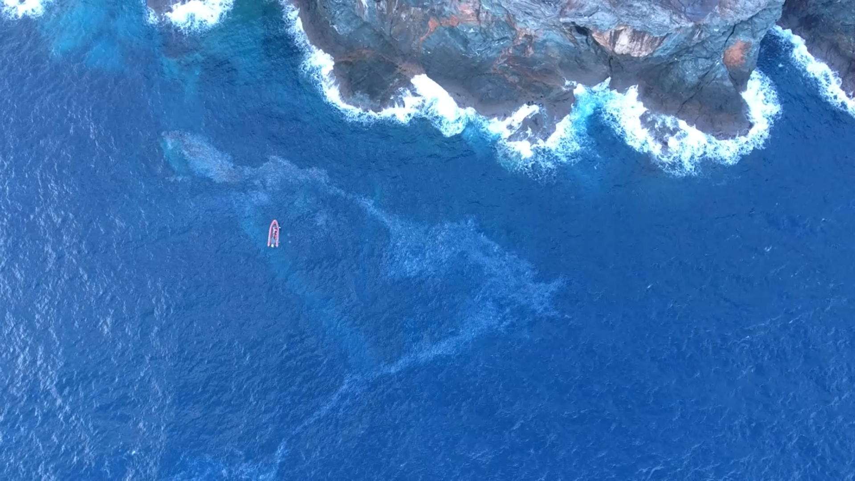
Oil removal from Wreck
A drone was used in the early stages to monitor the spread and extent of the oil pollution and for rearranging the oil booms

Slide 22
Oil removal from Wreck
The underwater survey revealed that the wreck was parted in a number of pieces with the engine room lying at a distance of about 150mtrs from the shore and at a depth of 35mtrs
A side scan sonar survey was carried out for further evaluation

Slide 23
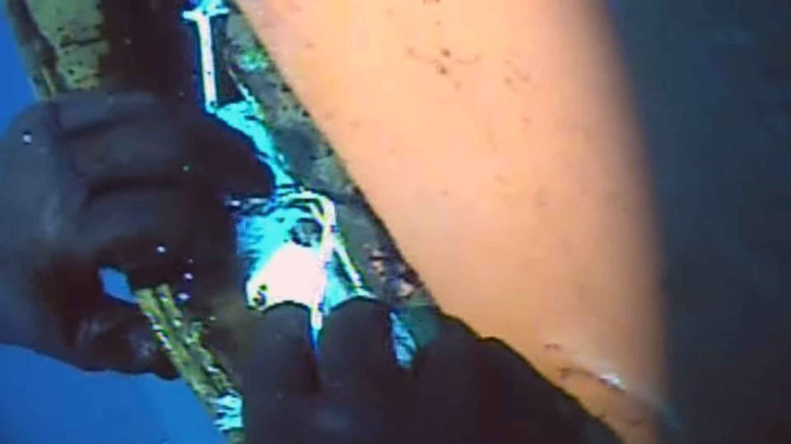
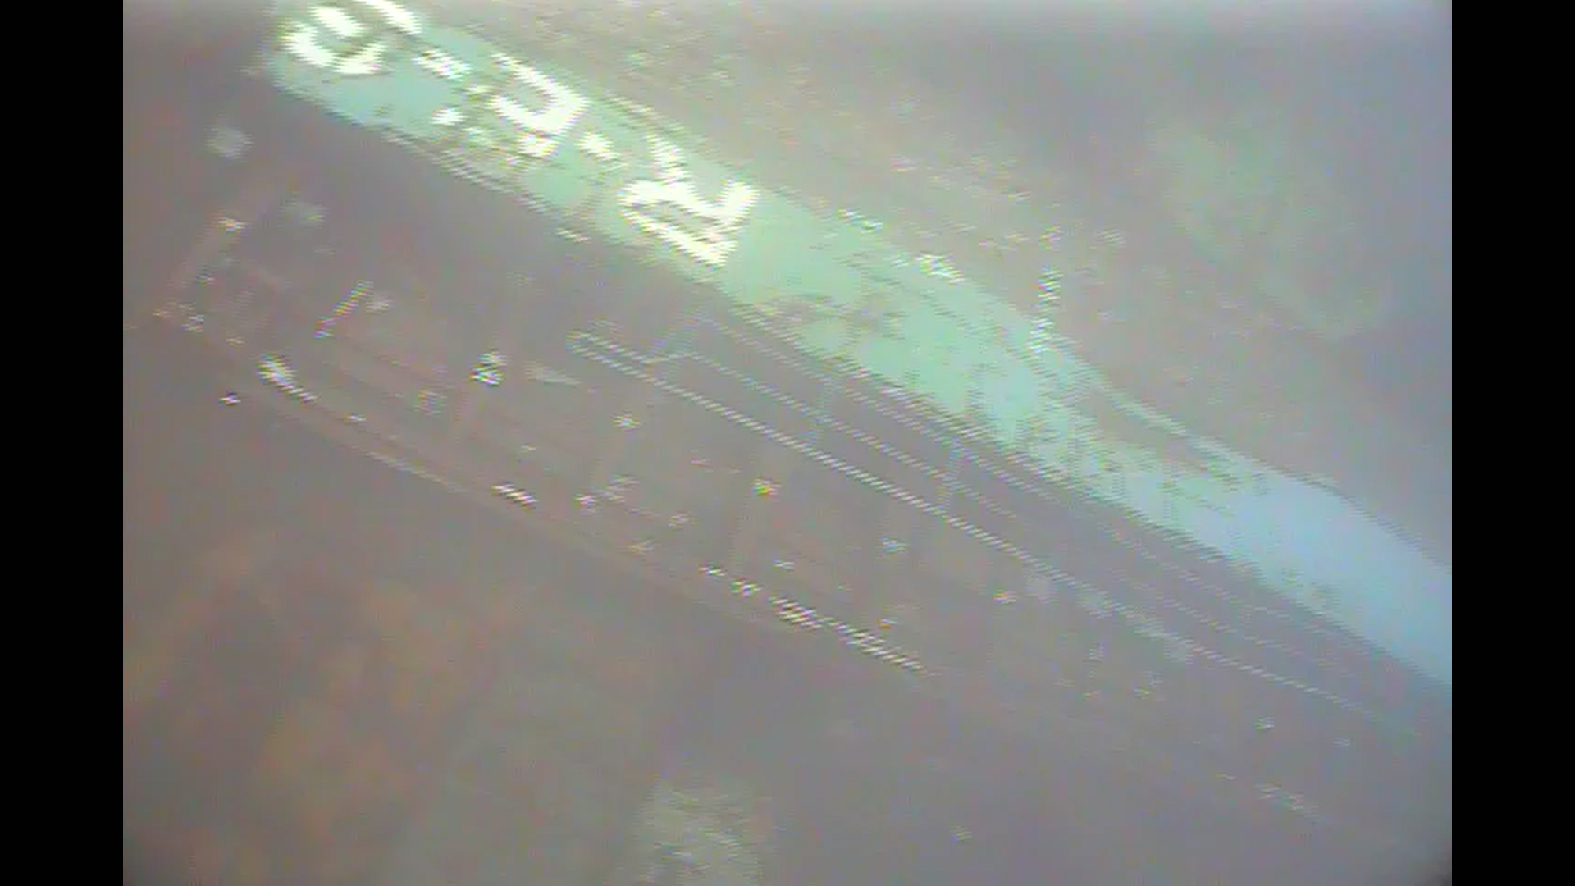
Oil removal from Wreck
Salvors first priority was to stop the continuing escape of fuel oil from the accommodation and engine room of the wreck
Various patching materials were used for the temporary sealing of the openings
Second priority was to locate the fuel tanks inside the engine room area

Slide 24
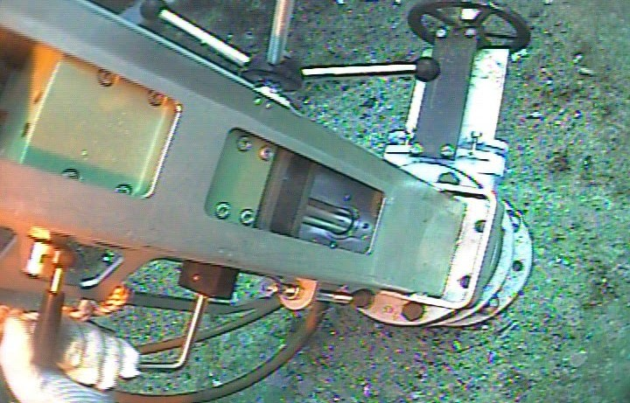
Oil removal from Wreck
Special underwater hydraulic tools (hottapping method) and pumping equipment were used for the drilling and pumping operation

Slide 25
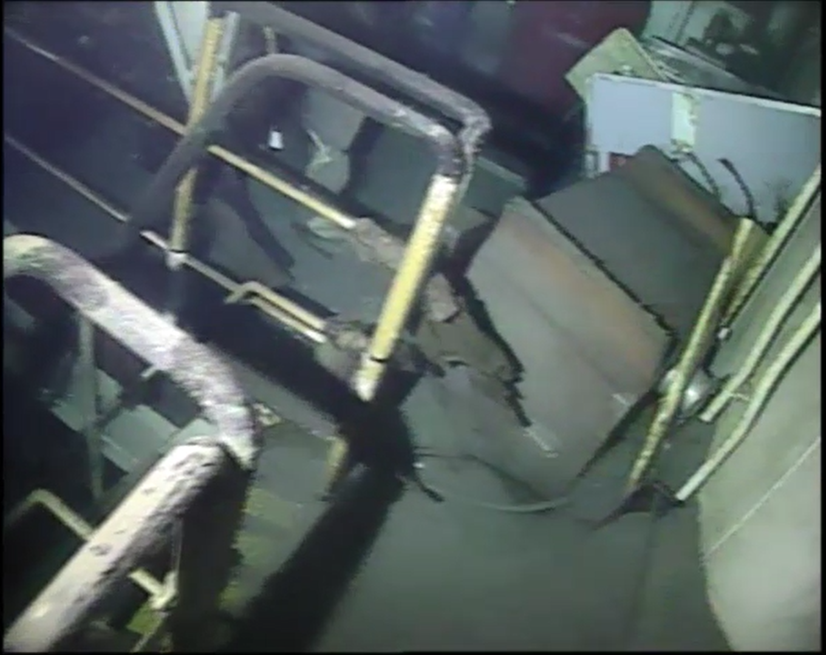
Oil removal from Wreck
Divers entered into the engine room via an emergency escape cover and by cutting the main deck plating for creating access.
The diving conditions were difficult and dangerous

Slide 26
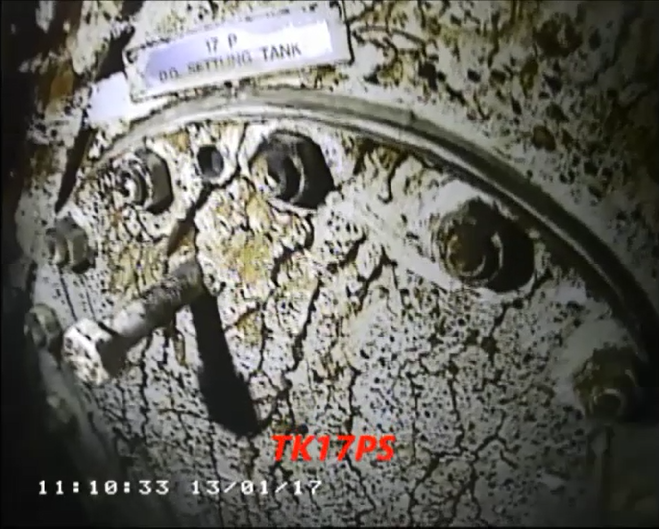
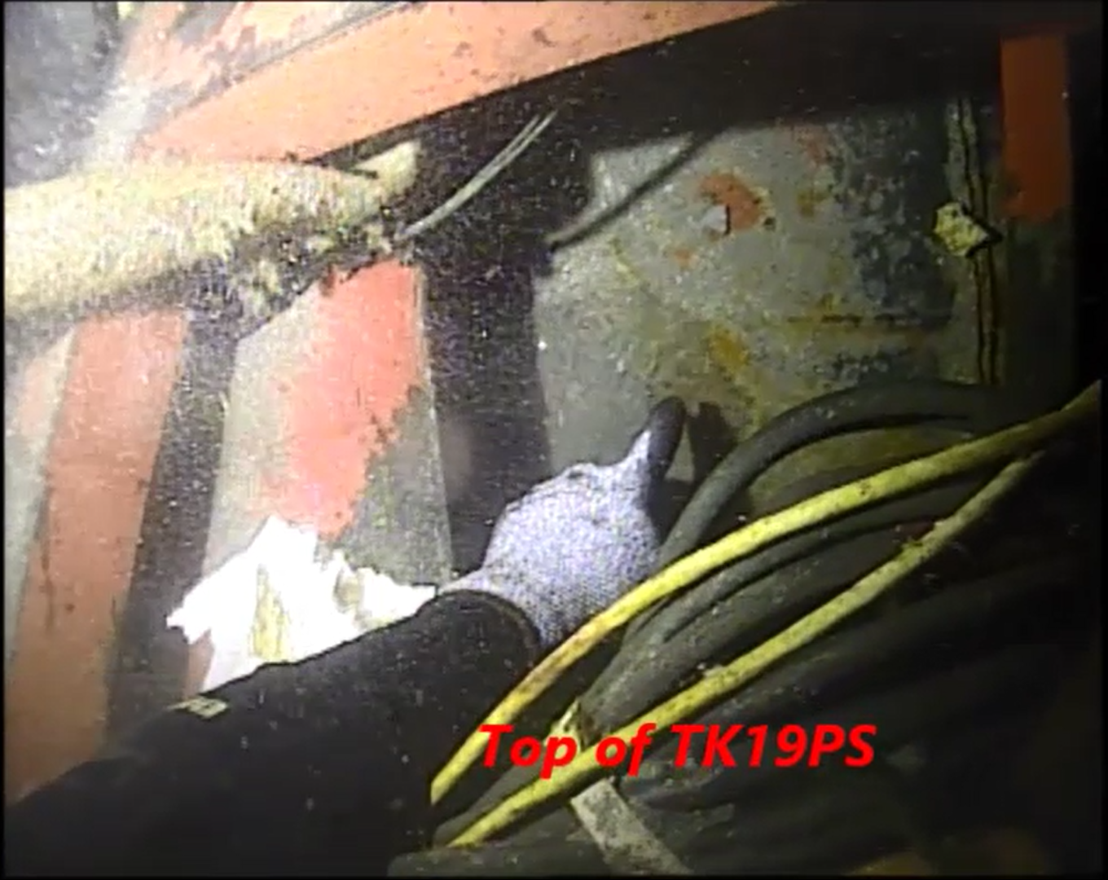
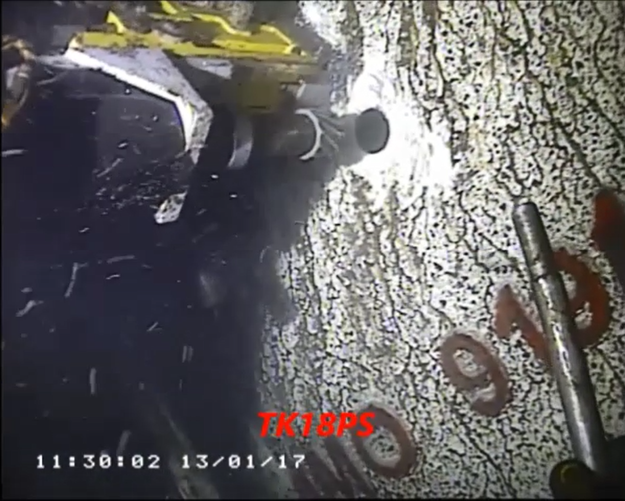
Oil removal from Wreck
Third task was to drill every fuel oil tank in order to remove the remaining fuel oil quantities

Slide 27
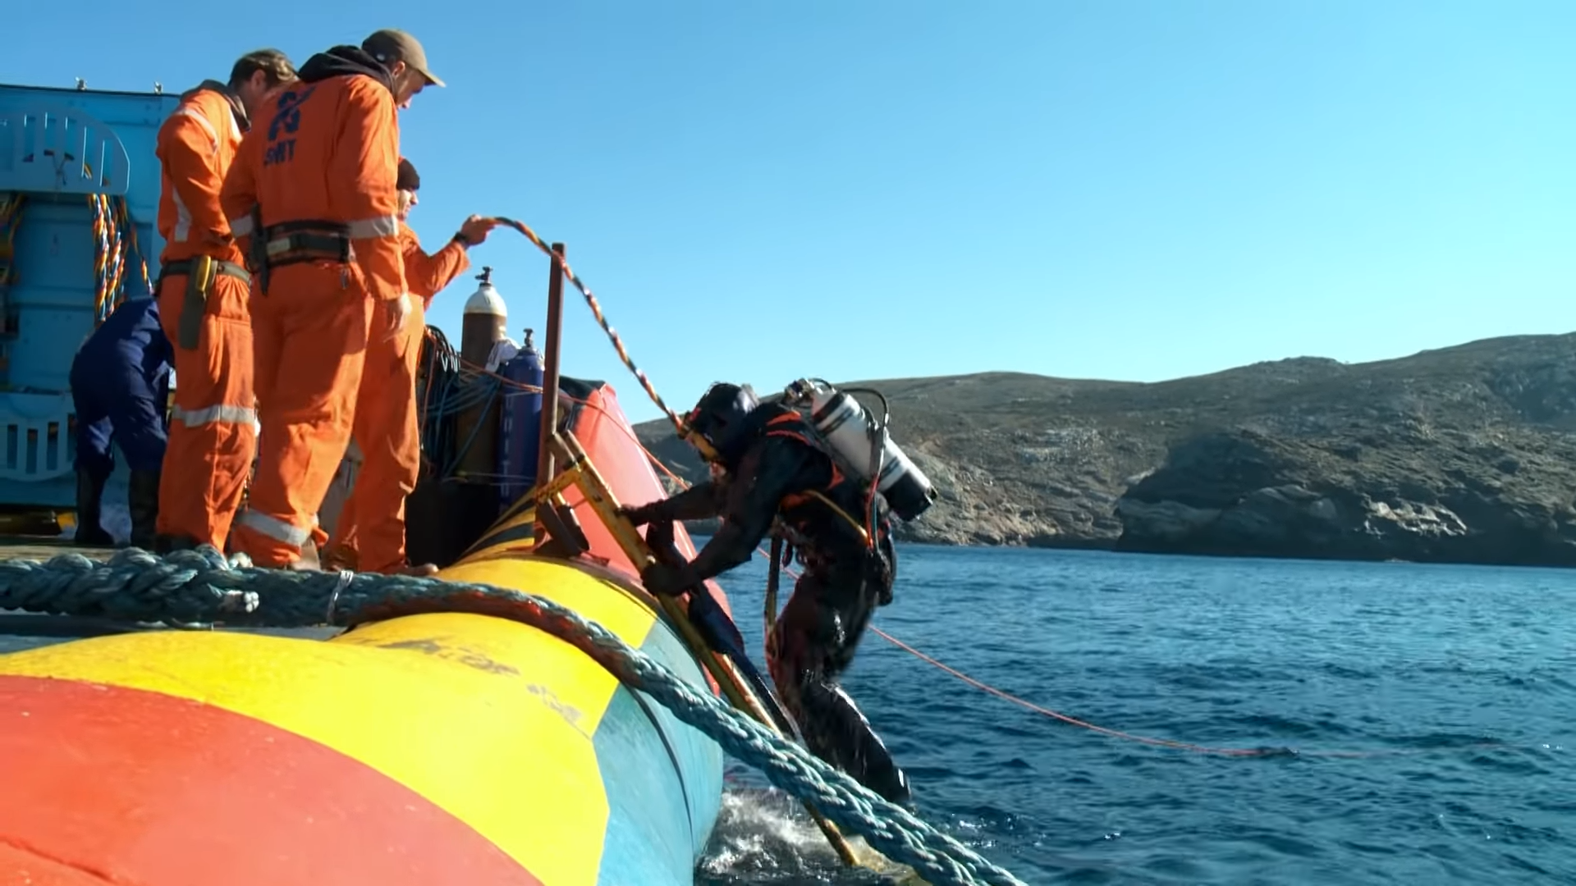
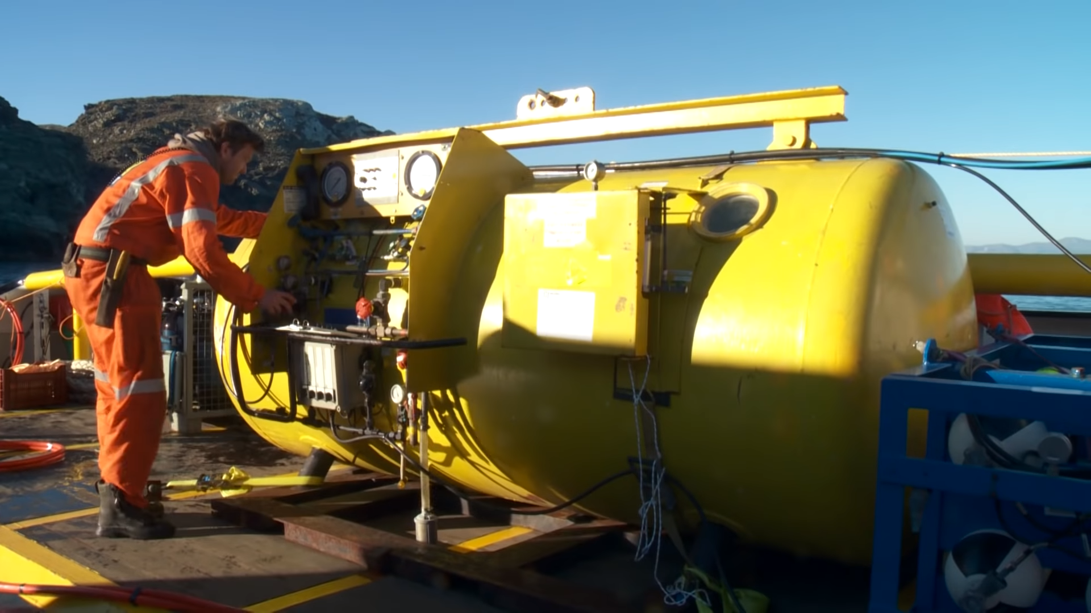
Oil removal from Wreck
A decompression chamber was utilized for the safety of the divers and to increase their bottom time

Slide 28
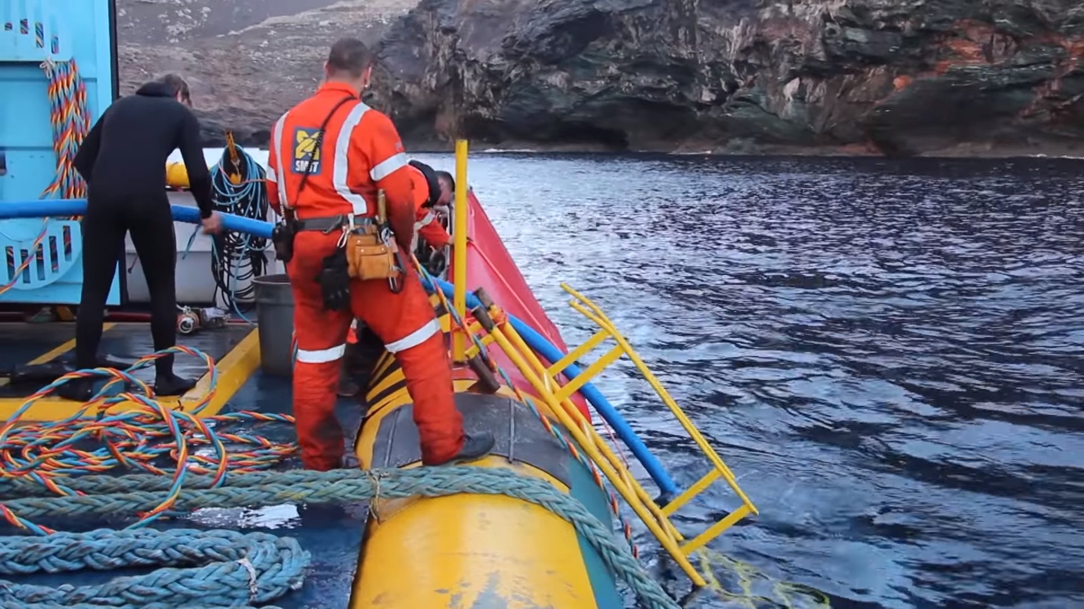
Oil removal from Wreck
The recoverable quantities of oil from the intact tanks and trapped in other areas of the wreck were pumped out and stored directly to the oil recovery tanks of the salvage tug Pantokrator
Pantokrator sailed to Piraeus port for the disposal of the oil pollutants
A quantity of 37.5 tons of oily slops was delivered to a licensed facility on 27/01/2017

Slide 29
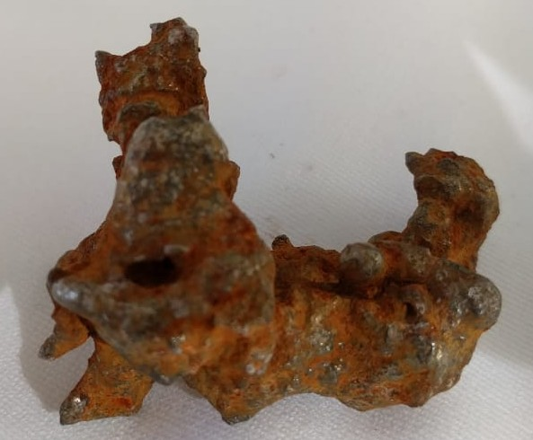
3. Salvage of cargo
Salvors and cargo insurers reached an agreement to salve the cargo under an LOF2011 contract
In the absence of an LOF agreement with the ship’s insurers, the LOF regime proved to be a useful tool even for cargo interests under the circumstances
There were 3,728 MT of ferronickel cargo with a sound value of € 6.12 million
The ferronickel was not damaged by being immersed in seawater and required only washing down with fresh water

Slide 30
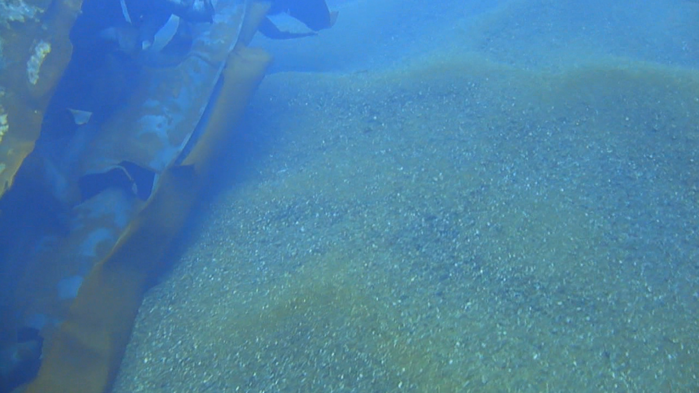
Salvage of cargo
The first LOF contract was the recovery of the estimated quantity of cargo remaining inside the hull
Salvors were unable to recover the cargo quantities remaining trapped under the large wreck pieces prior to the wreck removal operation
A second LOF contract signed with the cargo interests after completion of the wreck removal operation

Slide 31
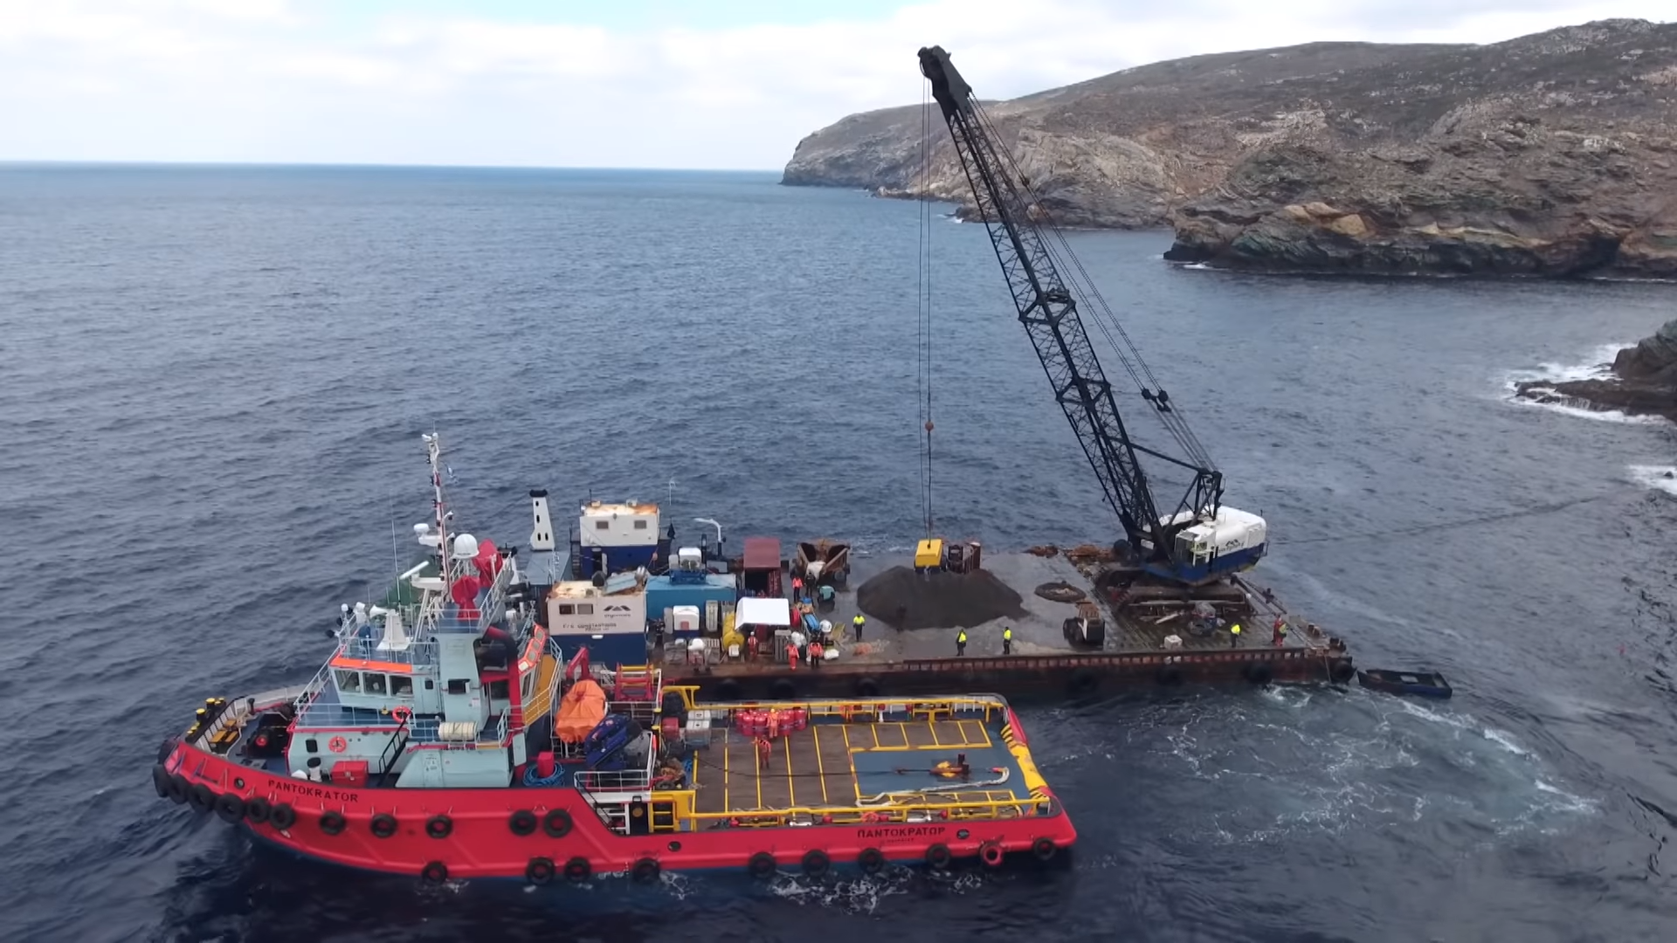
Salvage of cargo
A crane barge was towed from another Greek port to Andros island
It remained in Gavrion port for necessary deck preparations and to load salvage equipment (magnets, grabs, power packs etc.)
The crane barge was towed to the wreck site by one of the salvage tugs

Slide 32
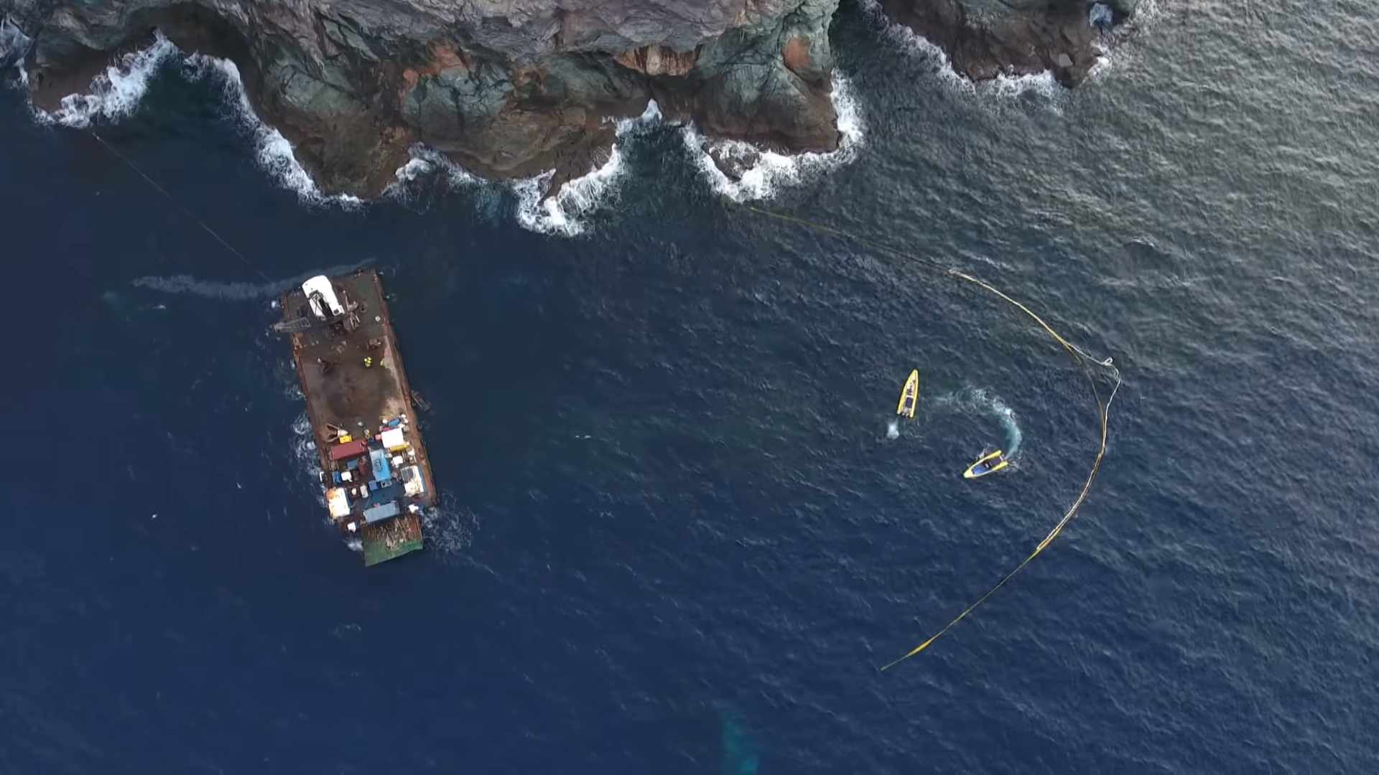
Salvage of cargo
The salvage tug assisted the positioning of the barge above the wreck by dropping her anchors to specific places
Divers marked the area and assist the cargo recovery
Oil booms were deployed to minimize the risk pollution

Slide 33
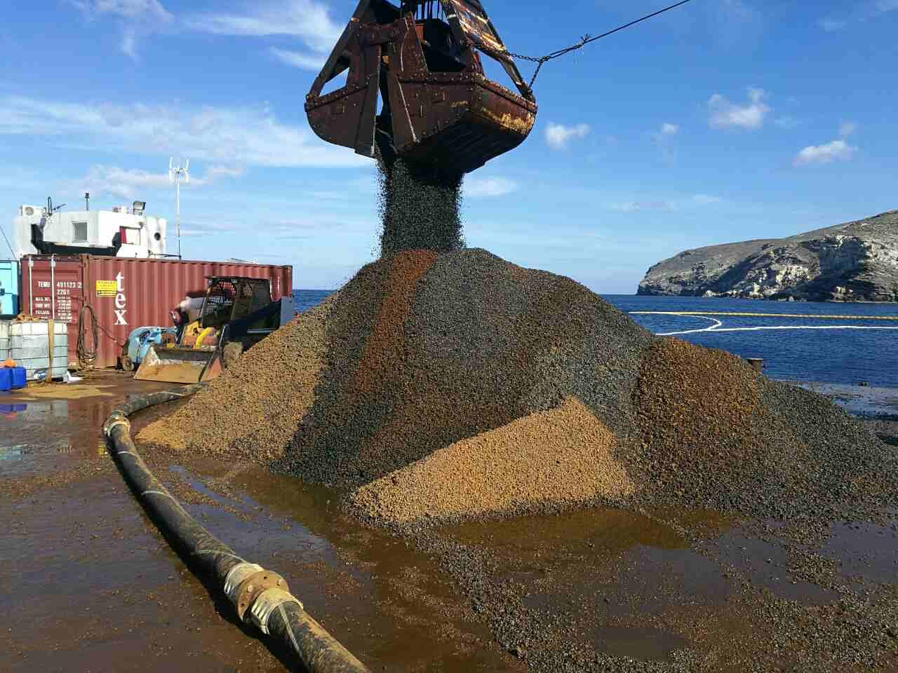
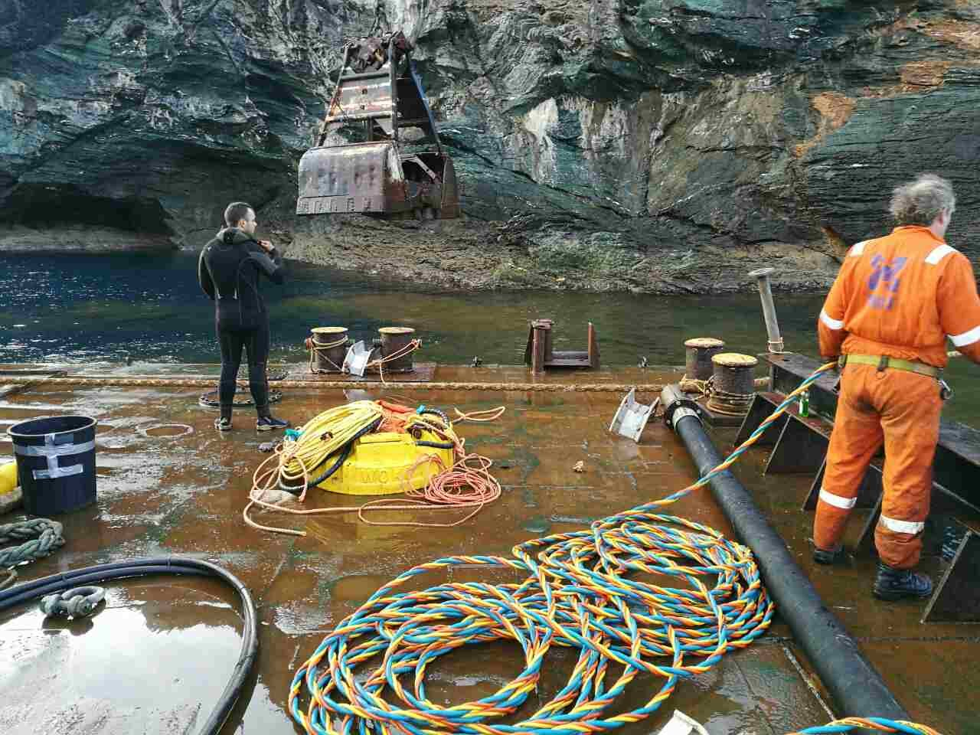
Salvage of cargo
The crane’s grab was used to recover the large quantities of cargo lying mainly on tank top of cargo hold

Slide 34
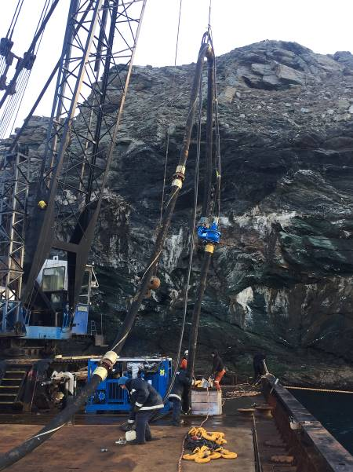
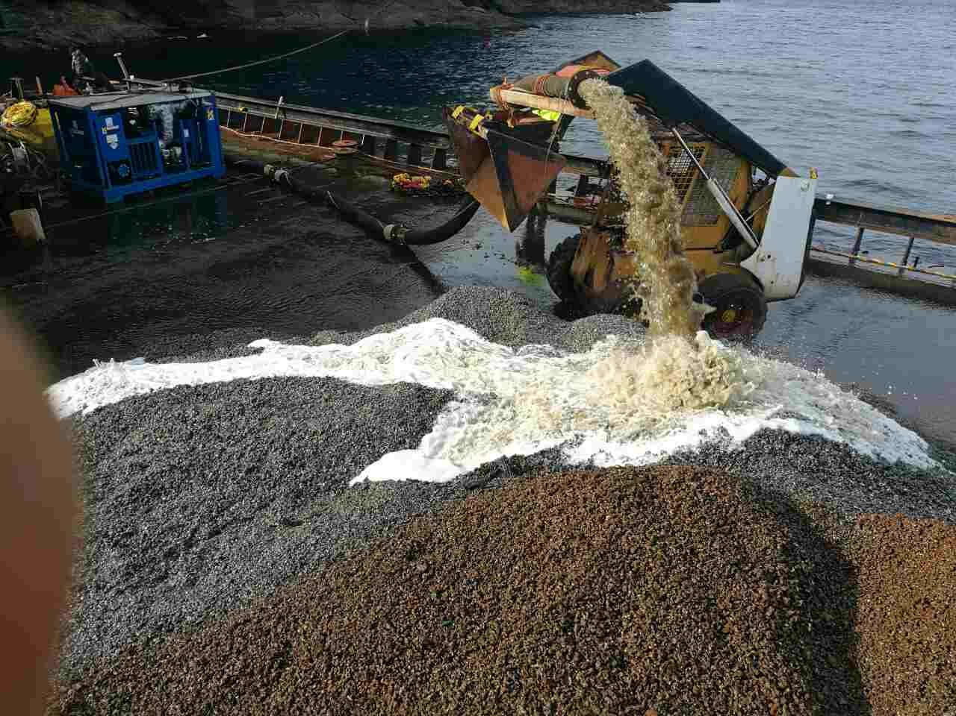
Salvage of cargo
Dredging pumps driven by divers were used to recover the cargo from the confined spaces and sea bed
Cargo stored on the deck of the barge and washed with fresh water at various intervals

Slide 35
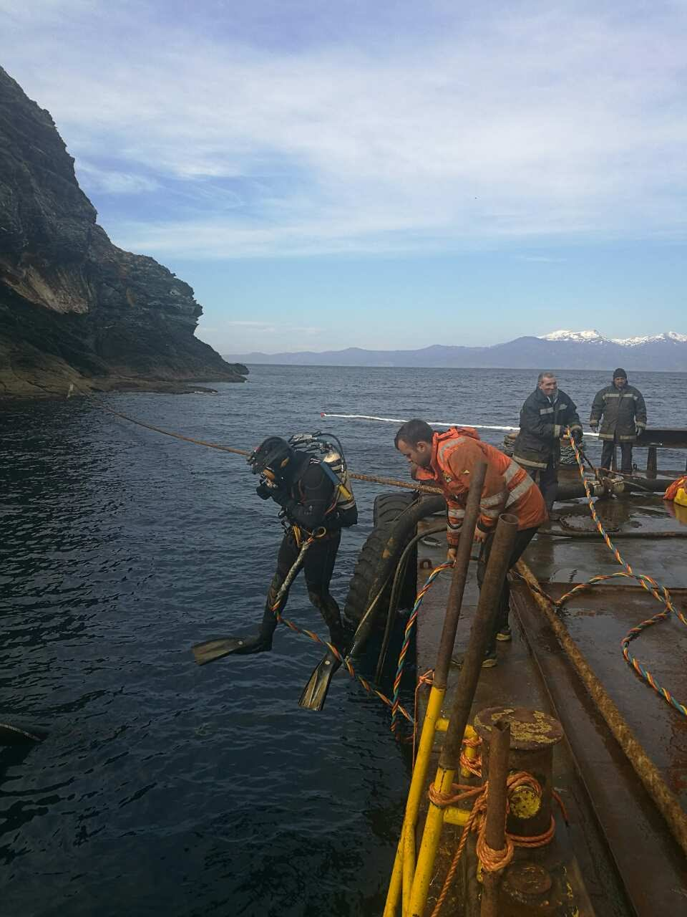
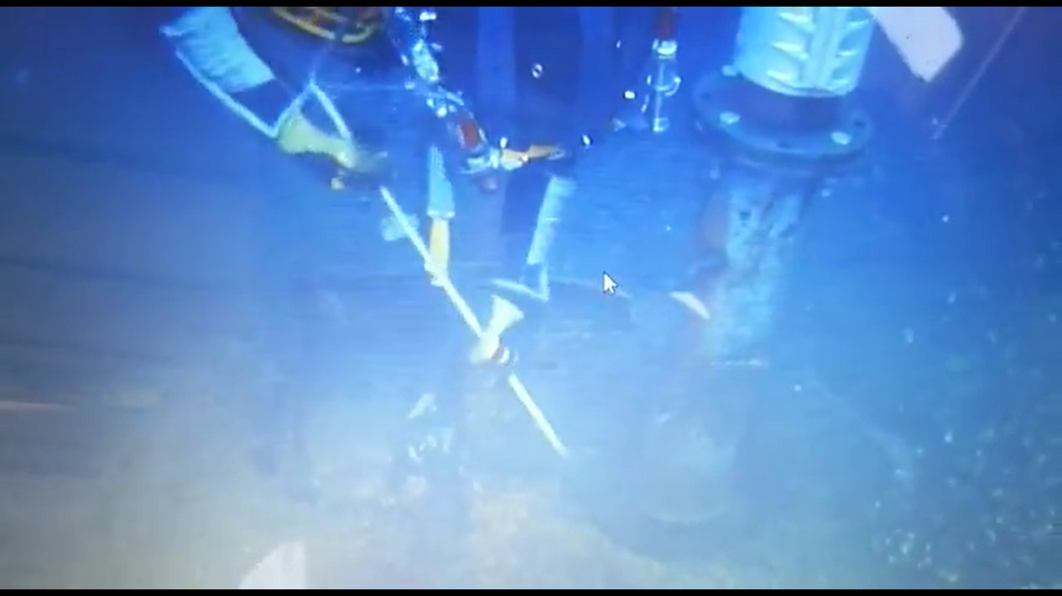
Salvage of cargo
Due to the delay in the wreck removal operation, the cargo had settled into lumps making it harder to be pumped out
It took more effort and time for the divers to break the lumps apart to allow pumping

Slide 36
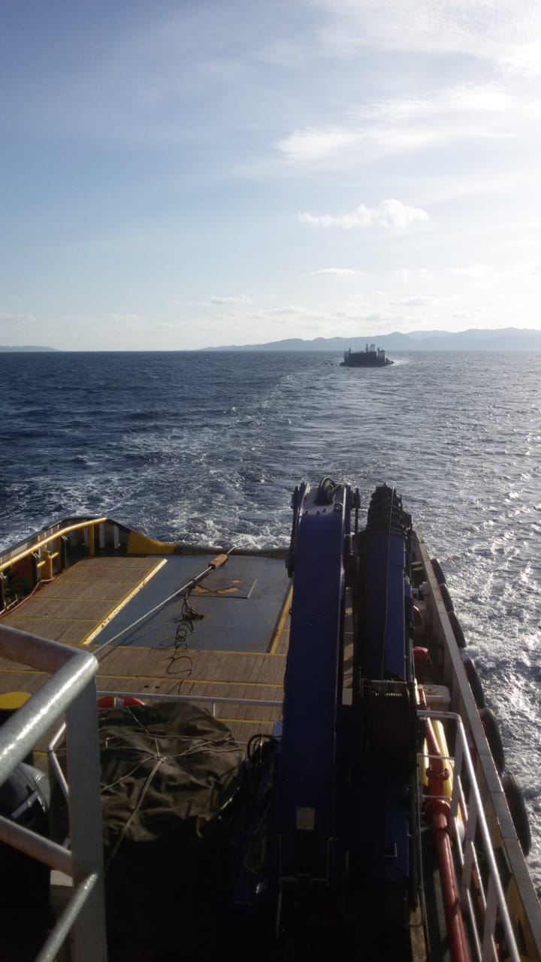
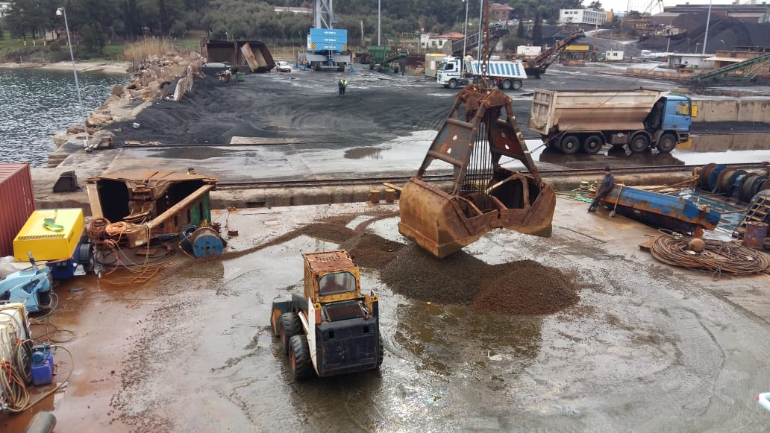
Salvage of cargo
The crane barge was towed, 4 times, to place of delivery of cargo which was on the mainland some 80 nm from the Casualty site
Salvors discharged the recovered cargo ashore by using the grab of the crane barge
The first phase of the cargo recovery operation lasted 38 days and second phase lasted 22 days

Slide 37
Salvage of cargo
Salvors recovered and delivered the following quantities of cargo:
1st LOF2011 1,519 MT
2nd LOF2011 520 MT
An amount of cargo spread in the sea bottom was not recovered in order to avoid serious damages to sea bed and ecosystem

Slide 38
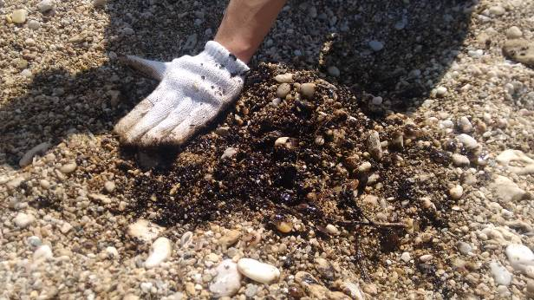
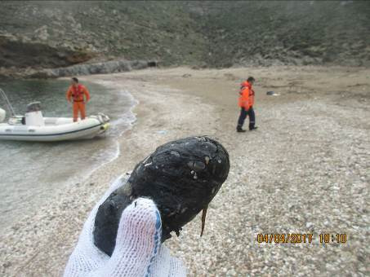
4. Wreck removal
Background of negotiations
Insurers were intending to exercise limitation of liability under the Wreck Removal Convention
This situation would have caused lengthy litigation between the Casualty’s interests and Greek Authorities
Pollution in the area was continuing from the remaining unpumpable quantities of oil pollutants in the stern section.
There were complaints from the local community (fishermen, tourists etc) especially during the summer season

Slide 39


Wreck removal
Contractors were obliged by Coast Guard to remain onsite to provide antipollution and clean up services
Greek Authorities reached an agreement with insurers for the removal of the stern section only (June 2017)
This process delayed the commencement of the wreck removal operation for a period of six (6) months

Slide 40
Wreck removal
Contractual arrangements
Contractors reached a WRECKFIXED 2010 agreement with insurers for the removal of stern section and debris
Contractors were obliged to take on the title and risk of the stern section upon signing of the contract
Contractors were directly responsible to the Greek Authorities after passing of the title
Contractors were responsible for the lawful disposal of the stern section to a licensed scrap yard
Contractors were obliged to provide Insurers with written confirmation for the removal of stern section, debris and cargo issued by Greek Authorities

Slide 41
Wreck removal
Condition of the wreck pieces
Casualty was in pieces, both the side shells of the cargo holds were lying on the bottom of the sea bed. The forward section was lying in a range of water depth between 12 meters and 25 meters. The stern section was lying further offshore in a water depth of 35 meters

Slide 42

Wreck removal
Cabrera Planning

Slide 43


Wreck removal
Phases of Execution
The following steps were undertaken by Contractors for the removal of the stern section :
Mobilization of the sheerleg Taklift 4, personnel and equipment
Preparation and outfitting of the Taklift 4 in Lavrion port
Preparation and outfitting of the scrap barge Atlantis V for loading the stern section
A steel barrier was constructed on her deck to contain the oil pollutants after the landing of the stern section

Slide 44


Wreck removal
Phases of Execution
Mobilization of personnel, craft and equipment to the worksite
Taklift 4 was positioned to the wreck site
Taklift 4 was self-propelled and able to sail and manoeuvre close to the wreck site
AHT Pantokrator was assisting to set out the anchors of Taklift 4

Slide 45



Wreck removal
Phases of Execution
Extensive dive works (welding, cutting, dredging etc.) took place for the rigging of the stern section
Lifting chains were installed to the area of the accommodation and propeller for the lifting operation

Slide 46

Wreck removal
Phases of Execution
Prior to the lifting operation the Contractors deployed oil booms around the wreck site for the containment of the oil pollutants

Slide 47



Wreck removal
Phases of Execution
Also, the beaches in the adjacent area were secured with oil booms to avoid being polluted again
The OSR team was conducting patrols from both the sea and shore sides. High speed boats were deployed for immediate response
OSR equipment were deployed onboard the crafts and other strategic places at shore ready for immediate response

Slide 48


Wreck removal
The stern section was lifted with 4 lifting chains rigged through and around this section
The various blocks and chains were able to be used independently, which was necessary to lift the stern section and to overcome possible suction effect from the sea bed
The total weight of the stern section was around 1200 tons

Slide 49



Wreck removal
Barge Atlantis V moored in front of the Taklift 4
The stern section was landed on the Atlantis V
Stabilizing stern section on the barge. - De-ballasting barge - Disconnected rigging

Slide 50



Wreck removal
Transit of stern section to berth at Lavrion port for obtaining scrapping permit
Further lashing works took place to secure the stern section on the deck of the scrap barge for the intended trip to Aliaga

Slide 51
Wreck removal
Execution of a Mesotec survey to evidence the removal of stern section and debris from the seabed

Slide 52


Wreck removal
Towage of barge to Aliaga, Turkey for the final disposal of stern section
Delivery of the stern section and passing of title to the scrap buyer
Barge remained in the scrapyard until the completion of the scrapping process by the scrap buyer
During remaining under the custody of the scrap buyer, the barge and wreck sunk in front of the shipyard as a result of bad weather conditions

Slide 53

5. Shoreline Clean-Up and Response
The Casualty caused massive pollution to a number of beaches, overviewed in the map below

Slide 54


Shoreline Clean-Up and Response
The area is part of Natura2000 network
Rare wildlife species live in Andros island

Slide 55



Shoreline Clean-Up and Response
There was a significant danger to wildlife
There was considerable media interest

Slide 56


Shoreline Clean-Up and Response
The clean up of the beaches was considerably hampered by the lack of infrastructure ( road access, electricity, water supply etc.)
Out of the 7 polluted beaches, 5 had no road access, with the remaining 2 accessible only by off-road vehicles and trucks

Slide 57



Shoreline Clean-Up and Response
An access road was cut into the hillside using a digger to allow access to the worst contaminated beach

Slide 58



Shoreline Clean-Up and Response
Once access to the polluted shores was established, transportation and deployment of OSR equipment began
Equipment storage places were established close to polluted areas to improve logistics and response time

Slide 59



Shoreline Clean-Up and Response
The initial phase of the operation included assessing the situation and collecting polluted debris
The oil debris were collected and transported with off-road vehicles, trucks and bulldozers
Wastes were stored to certified containers and skips (20-30m3)

Slide 60


Shoreline Clean-Up and Response
A landing craft was used to transport oil spill response equipment and remove waste from the beaches where there was no road access

Slide 61


Shoreline Clean-Up and Response
High speed boats were used to transport the oil spill response teams and equipment

Slide 62


Shoreline Clean-Up and Response
Oil booms were deployed to the polluted beaches for the containment of the oil pollution
Shore guardian booms were deployed on two beaches to avoid spreading of pollution to the adjacent lakes and streams

Slide 63



Shoreline Clean-Up and Response
Flushing
High volumes of low-pressure water were used to wash stranded and buried oil from the shoreline
The oil was recovered by the use of skimmers and absorbents

Slide 64



Shoreline Clean-Up and Response
Pressure washing
Cold high pressure washing method was utilised to clean specific areas in order to avoid damages to the ecosystem

Slide 65
Shoreline Clean-Up and Response
Damming
Temporary dams were constructed for the containment and skimming of the oil pollutants

Slide 66


Shoreline Clean-Up and Response
Skimming
The liquid oil wastes were collected by using various types of skimmers and absorbents
The recovered quantities were stored in fast tank containers

Slide 67

Shoreline Clean-Up and Response
Waste collection & disposal
Waste disposal was carried out in accordance with EU and IMO regulations
Five shipments, totaling about 273.5 mt of oil wastes were disposed of at a licensed waste facility

Slide 68

thank you for your attention

