Slide 1
Lextrasporti cantieri navali
Builder’s risk insurance: there where you need it?

Slide 2
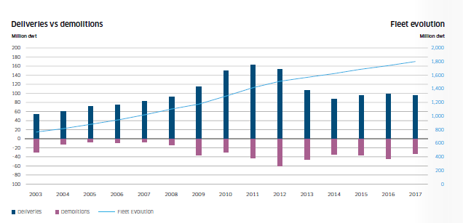
Builder’s risk
The shipbuilding market
New build prices rose between 5% and 20% in 2017
Global order book declined from 233.4m DWT to 222.4m DWT
Notes:
Credit to BRS Brokers
Rising build prices means rising insured values means higher premiuems

Slide 3
Builder’s risk
The state of the nation
Notes:
16 syndicates not made a profit for 3 years
34 syndicates unprofitable in marine for the last 3 years (47 over 7 years)
Require new business plans to be provided by Lloyds showing a “near term” route to profit
Insurers pulling out of marine
AmTrust, Acappella, Advent, Barbican, Brit, Channel, MS Amlin, Standard Syndicate and TMK
Builder’s risk historically profitable but, rates are only going up as a result of Lloyds reforms reducing capacity and recent very large losses.
Lancashire and RSA have issued profits warnings as a result of the Lurssen fire
Minimum 5% increases on renewal this year
Same next year and year after?

Slide 4
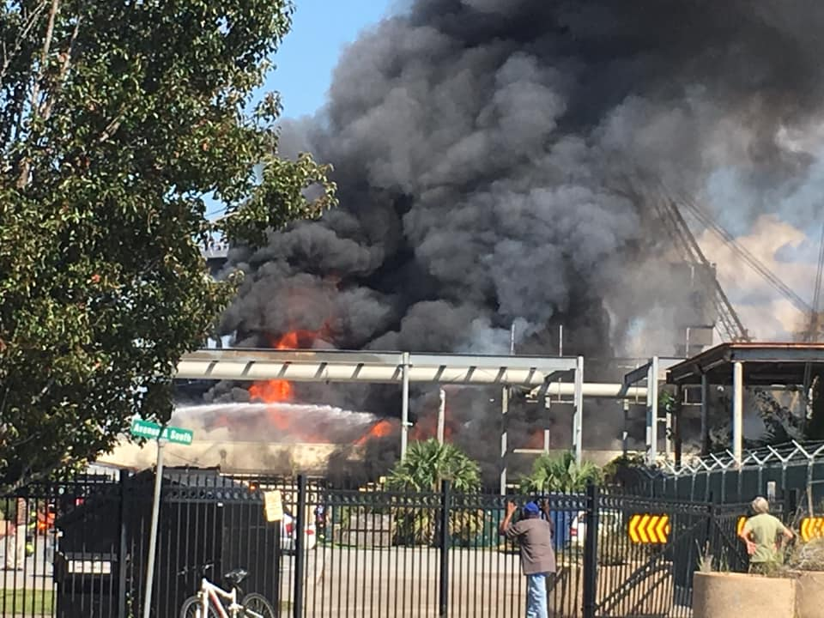
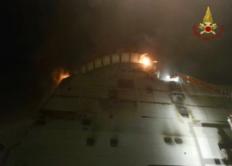
Builder’s risk
A timely reminder
Notes:
Lurssen shipyard
North Charleston shipyard October 2018
Fincantieri Mugiano July 2018
Portsmouth Naval Shipyard USA
Mississippi Gulf Coast Shipyard October 2018
Gadani Coast Shipyard October 2018
Cochin Shipyard February 2018

Slide 5
Builder’s risk
What is the concern
The primary concern is usually fire but also:
Earthquake
Flood
Security
Ease of launching
Sea Trials and Delivery Trips
What are the risks:
Complexity and therefore the length of the construction
Use of modular construction
Installation of specialised machinery
Higher component of flammable furnishings (yachts, cruise and passenger vessels)
Use and sophistication of control and monitoring systems
Notes:
From AIMU
Fire Protection
COPE Factors
- Age and construction of facility
- Distance between structures
- Sprinkler systems / alarms
- Does the yard have its own fire company? If not:
o Distance to fire pump and firehouse? Is nearest fire department volunteer or paid?
o Does the yard conduct drills the local firefighters?
o Do the local fire companies have any training in fighting a fire aboard ship?
- Housekeeping and storage
- Storage of flammables
- Hot work procedures
- Paint, fiberglass work

Slide 6
Builder’s risk
Institute clauses
Declaration
Many vessel included in a given period
Insurers bound to accept valid declarations in that period
Protects yard from future premium fluctuations
Single Risk Policy
Each vessel on separate policy
Yard may “shop around” each time

Slide 7
Builder’s risk
Institute clauses
Institute Clauses for Builder’s risk (01/06/88)
An all risks regime
Requires physical damage
Ranicar v Frigmobile Pty Ltd [1983] Tas R 113
Covers salvage and general average
Covers collision liability
Excludes
Personal injury, pollution, wreck removal
Workmen’s comp, cargo, builder’s property, cash, precious metals/stones valuables etc.
War, strikes, nuclear exclusion, earthquake, volcano
Notes:
“In my view, the ordinary meaning, and therefore the meaning which I should prima facie give to the phrase "damage to" when used in relation to goods, is a physical alteration or change, not necessarily permanent or irrepairable, which impairs the value of usefulness of the thing said to have been damaged. It follows that not every physical change to goods would amount to damage. What amounts to damage will depend upon the nature of the goods.”
No reported case on Institute Clauses for Builder’s Risks

Slide 8
Builder’s risk
What are the problems
Institute Clauses for Builder’s risk (01/06/88)
Law and jurisdiction
Identity of the assured
Does a latent defect which has not caused damage trigger cover
“SUBJECT ALWAYS TO ITS TERMS, CONDITIONS AND EXCLUSIONS this insurance is against all risks of loss of or damage to the subject-matter insured caused and discovered during the period of this insurance including the cost of repairing replacing or renewing any defective part condemned solely in consequence of the discovery therein during the period of this insurance of a latent defect. In no case shall this insurance cover the cost of renewing faulty welds.”
Notes:
Note that the NMIP includes buyer as co-insured.

Slide 9
Builder’s risk
What are the problems
Institute Clauses for Builder’s risk (01/06/88)
Latest defect (clause 5) vs defective design (clause 8)
...including the cost of repairing replacing or renewing any defective part condemned solely in consequence of the discovery therein during the period of this insurance of a latent defect...
...this insurance includes loss of or damage to the subject-matter insured caused and discovered during the period of this insurance arising from faulty design of any part or parts thereof...
Constructive loss language Clause 12? Unrepaired damage language Clause 11?
Notes:
The issue of construction which arises is how this provision interacts with the “defective part” cover in clause 5. It might be argued that the exclusion from cover of repairing the design-defective part does not apply if it otherwise falls within the “defective part” cover in clause 5; in other words if the design defect is “latent”, there is cover. However, I think that such an argument is wrong, and that if the relevant defect can be described as a design defect, there is no cover for the repair of that design defect, whether latent or not, but there remains cover for loss or damage caused by that design defect. I reach this view, primarily because it is a less contorted construction and because of the opening words of clause 8 “Notwithstanding anything to the contrary which may be contained in the policy …”.

Slide 10
Builder’s risk
What are the problems
Marine Insurance Act 1906
section 55
“The insurer is not liable for any loss attributable to the wilful misconduct of the assured, but, unless the policy otherwise provides, he is liable for any loss proximately caused by a peril insured against, even though the loss would not have happened but for the misconduct or negligence of the master or crew;”
Insurance Act 2015
section 3
“Before a contract of insurance is entered into, the insured must make to the insurer a fair presentation of the risk”
Notes:
Circle back round to who the assured is?

Slide 11
Builder’s risk
Interaction with build contract
Who places the risk? Who pays the premium?
What is the insured value? Owner’s equipment?
Who controls the claims process?
Access to staff, yard, documents etc.
Who are the insurance funds paid to? The yard or the owner?
Linked into whether a replacement vessel will be constructed.
Who funds the deductible?
Notes:
Circle back round to who the assured is?

Slide 12
Conclusion
Notes:
Strong shipbuilding market
Weak insurance market
Large losses
Rates will go up.
Wordings key along with interaction with build contract. This losses do happen.

